Slide 1


Pruning Trees
Notes:
Pruning is a technique that reduces the size of decision trees by removing sections of the tree that provide little power to classify instances. Pruning reduces the complexity of the final classifier, and hence improves predictive accuracy by the reduction of overfitting. This presentation covers the basic idea behind pruning of decision trees and provide examples.

Slide 2
Stopping Tree Growth
Natural end of process is 100% purity in each leaf
This overfits the data, which end up fitting noise in the data
Overfitting leads to low predictive accuracy of new data
Past a certain point, the error rate for the validation data starts to increase
Notes:
If you allow the algorithm to continue splitting, it will only stop when we achieve 100 percent purity in all of the leaves. This means that the decision tree would overfit the data, and capture not only the actual patterns in the data, but also noise. Overfitting leads to low predictive accuracy of unseen data. In other words, the tree works perfectly fine on the training data which the tree has been trained on, but the performance would be very low for predicting unseen data. Because of that, we normally divide the data into train and validation. Validation data refers to the part of the data that has not been included in the training phase. We can use the validation data at the end to evaluate the performance of a decision tree.

Slide 3
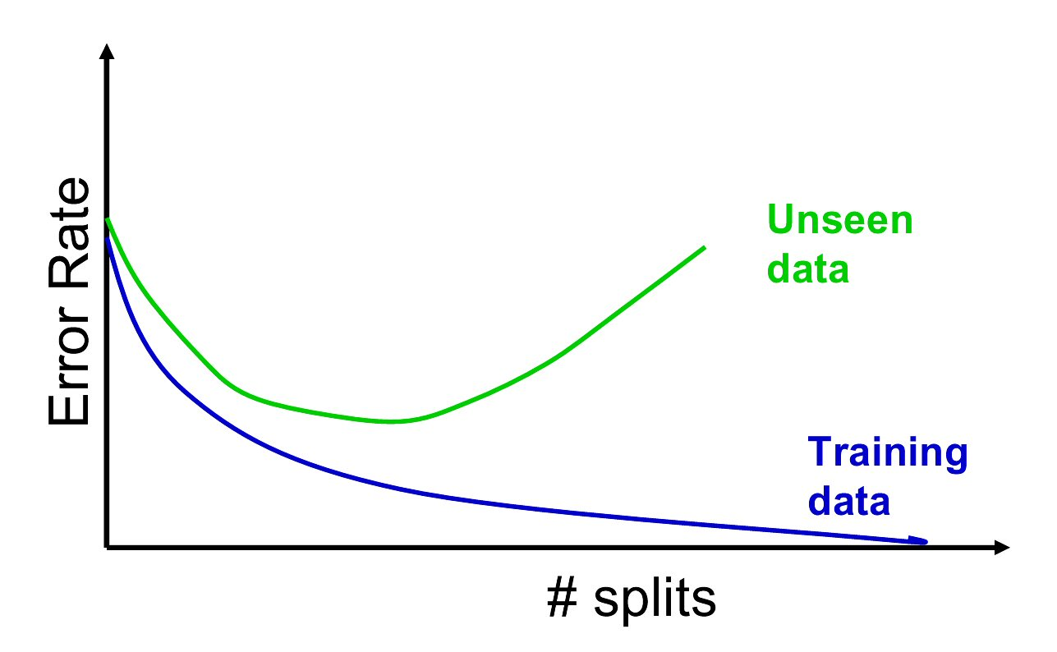
Full Tree Error Rate
Notes:
This slide shows a visualization of the overfitting effect. As we can see, as we increase the number of splits, the error rate on the training data goes down. This is because the tree finds different splits and can accommodate all the data points in the training data so that the classification error on the data set is minimized. However, as we said before, this results in overfitting and capturing unnecessary noise as well. As a result of this, the error rate on the unseen data may start to increase. As soon as we start seeing a gap between data performance and the unseen data and the training data, we can conclude that the model has started to overfit. Therefore, choosing a tree with an optimal number of splits is of critical importance.

Slide 4
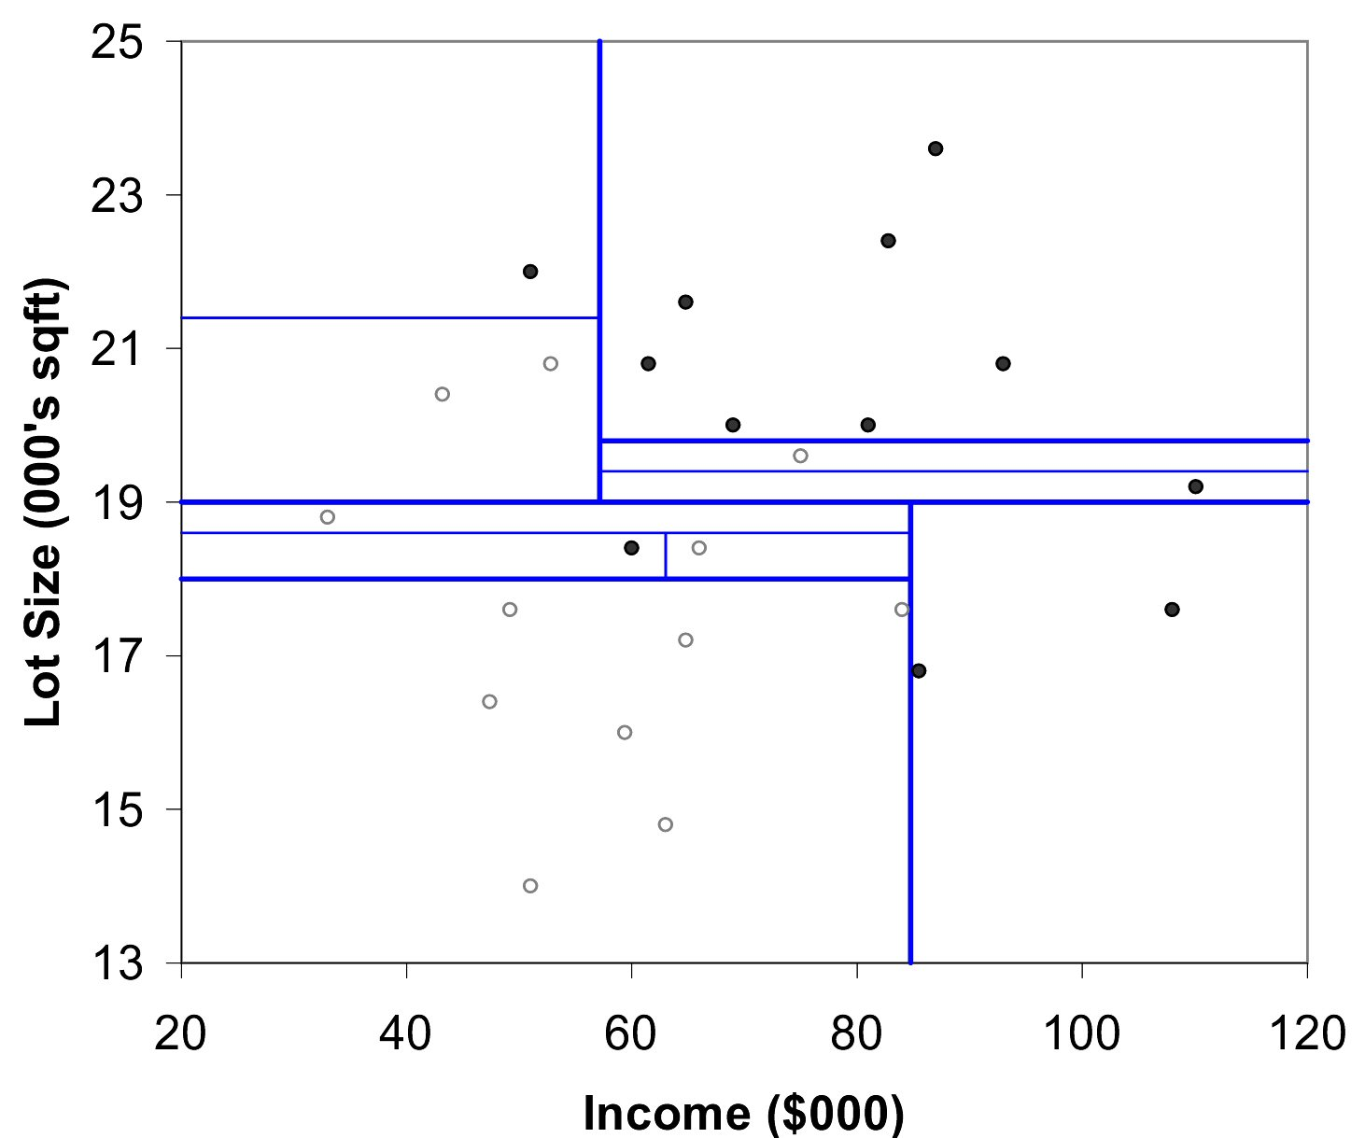
Example
Notes:
This slide shows a visual representation of the overfitting effect. As we can see, we have so many partitions and so many splits. From the result, we can see that the purity of each partition is 100 percent. In other words, each partition contains data points that all belong to the same class. However, as you might imagine applying this to unseen data results in poor prediction performance.

Slide 5
Pruning
CART lets tree grow to full extent, then prunes it back
Idea is to find that point at which the validation error begins to rise
Generate successively smaller trees by pruning leaves
At each pruning stage, multiple trees are possible
Use cost complexity to choose the best tree at that stage
Notes:
When using the CART algorithm, the algorithm allows the tree to grow fully and then starts to prune the tree. The idea is to find the optimal point where the validation error starts to increase which is the start of the overfitting. As such, the algorithm starts to prune back the tree until the optimal number of splits is reached. For this, we need to consider a complexity measure and to modify the objective function so that the optimal tree is selected.

Slide 6
Cost Complexity
CC(T) = Err(T) + α L(T)
CC(T) = cost complexity of tree, T
Err(T) = proportion of misclassified records
L(T)= the number of terminal or leaf nodes in T
α = penalty factor attached to tree size (set by user)
Among trees of given size, choose the one with lowest CC
Do this for each size of tree
Notes:
So as we can see, the cost complexity of a tree, or the objective function of a tree, shown as CC consists of two elements, the error component or the Err refers to proportion of the misclassified records on the training data set. On the other hand, the complexity part, refers to the number of leaves, or the terminal of the tree. Alpha is the parameters that try to balance these two factors. In fact, we are looking for a tree which is low error, but at the same time low complexity as well.

Slide 7
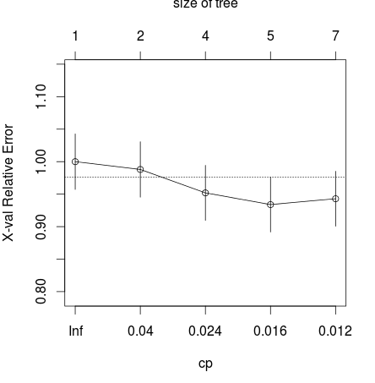
Cost Complexity
Notes:
Here is an example, in this case as you can see, we can change the CP or the complexity parameter of a tree which is the same as the alpha and see the effect of it on the relative error of the data, as well as the size of the tree. So, if CP is equal to infinity, it means that we are putting all the rates on reducing the complexity. Obviously, this is in an extreme case which results in a tree which only contains one single root node. When CP starts to decrease, it means that we are applying less penalty for the complexity. As a result, the size of the tree starts to increase, as you can see, with the increase in the size of the tree, the relative error of the tree on the training data set starts to decrease as well.

Slide 8
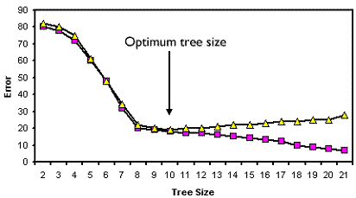
Using Validation Error to Prune
Notes:
This slide shows a visual representation of the error, both for the training data set which is shown in pink and the validation data set which is shown in yellow. As shown, increasing the tree size always results in reducing the error for the training data. This is because with more split, the tree is better able to accommodate the training data set. Whereas we discussed before, at some point the tree may start to capture noise and therefore overfit. The optimal tree size is defined as a point where the error on the validation and training data set start to differ.

